Slide 1
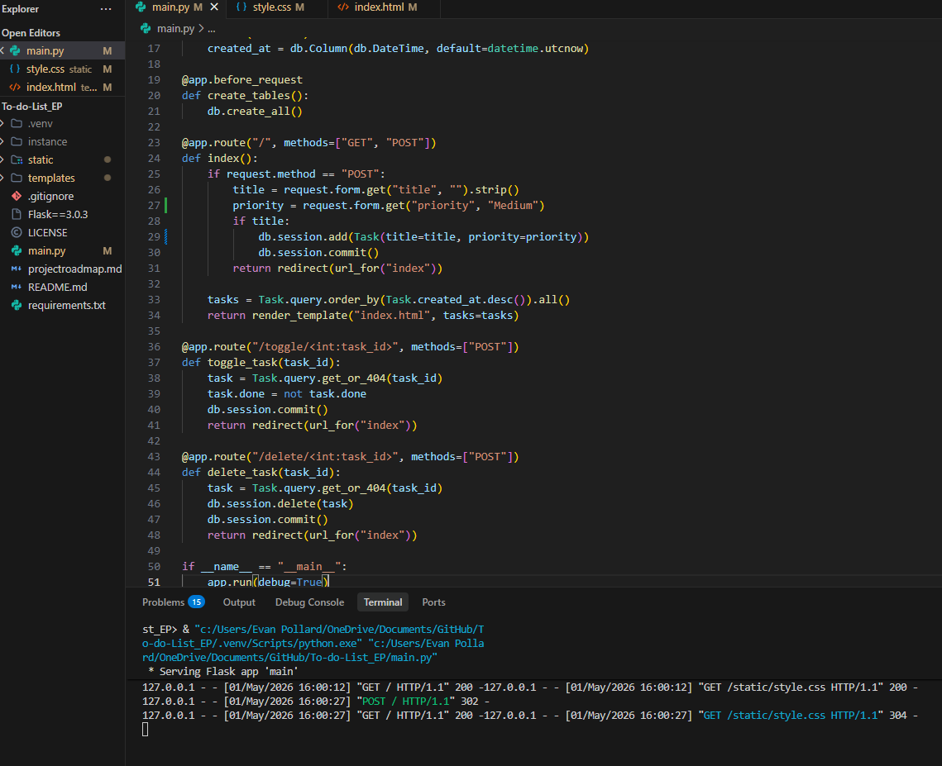
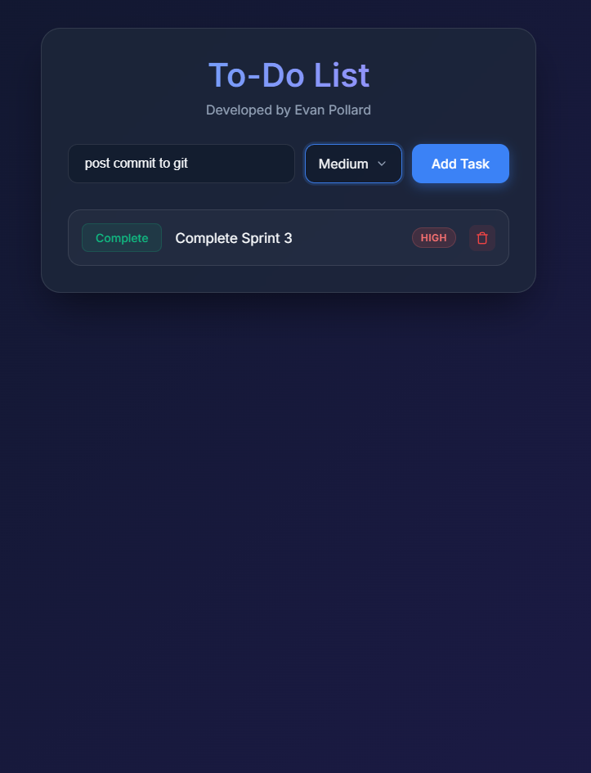
Custom To Do List
By: Evan Pollard
More feature coming soon!
Custom made for my needs
- Includes a priority ranking feature

